Slide 1
Security in iOS Applications
TEK306: Sikkerhet i mobile applikasjoner

Slide 2
  Contents
What is iOS?
Understanding iOS Architecture
iOS applications- categories, distribution, structure
iOS Security Model- secure boot chain, secure enclave, code signing, sandboxing
Data-at-rest encryption
Exploit mitigation features
More on security features- permission, API, keychain
Reverse engineering, jailbreaking
Writing Secure iOS Applications

Slide 3
  What is iOS?
iPhone Operating System (iOS)- developed by Apple Inc. and distributed exclusively for Apple hardware.
iOS is derived from OSX- which is also based on the UNIX operating system.
It powers- iPhone, iPod, iPad, Apple watch, and Apple TV.
Apple designed the iOS platform with security at its core.
It has several versions the latest being iOS 16

Slide 4
  iOS Architecture
iOS has a layered architecture:
  => Apps do not communicate to the underlying hardware directly.
  Core OS Layer- consist of components that provide low-level services- hardware, network, kernel and device drivers.
  Core Services Layer- consist services like WebKit, Address book, Security, Social and gives access to fundamental resources needed for app.
  Media Layer- help you to use 2D and 3D graphics, animations, image effects, and professional-grade audio and video functionalities into mobile app.
  Cocoa Touch Layer- appearance of apps, access to system functions like Contacts, Camera, touch input, shares with other apps, push notifications etc.

Slide 5
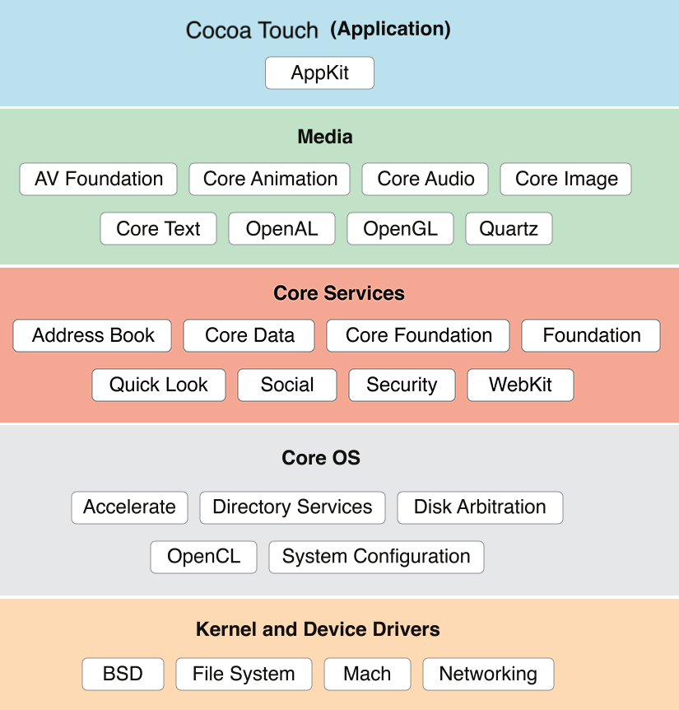
  iOS Architecture …
Layered architecture

Slide 6
  iOS applications- categories
  Standard native app- in Objective-C or Swift- also mixture of Objective-C, C, or C++.
  Browser-based app- mobile-friendly web app to render in iOS web views (e.g., MobileSafari):
    Uses HTML, JavaScript, and CSS (and web security).
  Hybrid app- used with a native wrapper to display browser-based apps using a mobile web view.

Slide 7
  iOS Applications- distribution
  Apple App Store - is the official distribution market where users download iOS apps.
    Before developers publish apps they must have an Apple developer account and own developer certificate.
  Enterprise distribution- iOS enterprise developer program allows organizations to develop and distribute in-house app to employees.
  Why do enterprises employ their own distribution centers?
Notes:
This is used by organizations having internal applications that they do not want to be available in the App Store.

Slide 8
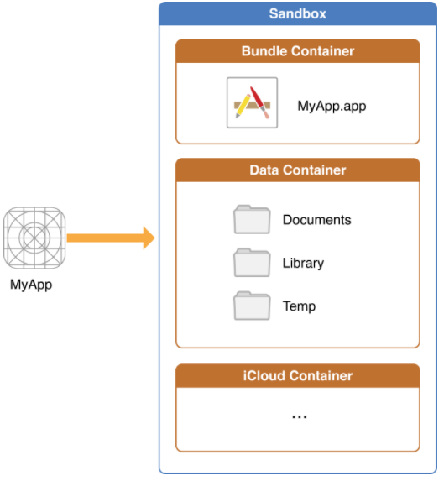
  iOS Applications- structure
  iOS apps are distributed as iOS App Store package (IPA) archive.
  It is a compressed package containing the necessary- compiled code, resources, and metadata required by a complete app.

Slide 9
  iOS Applications- installing
  Method 1: How to Install IPA on iPhone with Online IPA Installer
  Method 2: Install IPA with Cydia Impactor- if file is on computer
  Method 3: Install IPA on iPhone Directly without Computer
  Details on development and testing.

Slide 10
  iOS Security Model
The core security features of the iOS:
  Secure boot chain
  Code signing
  Process-level sandboxing
  Data-at-rest encryption
  Native exploit mitigations: e.g. randomization in RAM

Slide 11
  iOS Security Model- Secure boot chain
  A process by which the firmware is initialized and loaded on iOS devices at boot time– as first layer defence.
  In each boot step, each component is cryptographically signed by Apple and verified later to ensure that it has not been modified.
  Components- Boot ROM, low-level bootloader (LLB), iBoot image in flash memory, iOS kernel, .. then the iOS Apps.

Slide 12
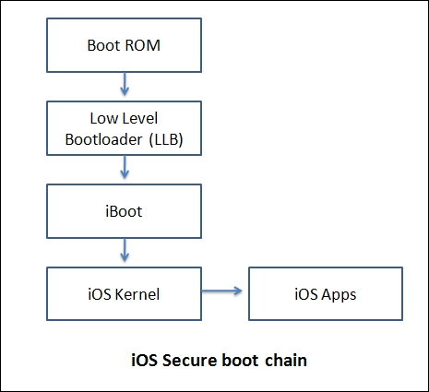
  iOS Security Model- Secure boot chain …

Slide 13
  iOS Security Model- Secure enclave
  It is a separate processor and runs its own microkernel to handle your biometric information.
    => not directly accessible by OS or any program running on a device.
  It provides all cryptographic operations for maintaining the integrity of biometric data- Touch ID and Face ID.
  E.g., Using biometric security as a car key.
  But, not used for- software update, device erasing, passcode settings, and configurations- instead passcode is used.
Notes:
Secure Enclave- The probability that a random person in the population could unlock your iPhone is 1 in 50,000 with Touch ID or 1 in 1,000,000 with Face ID.

Slide 14
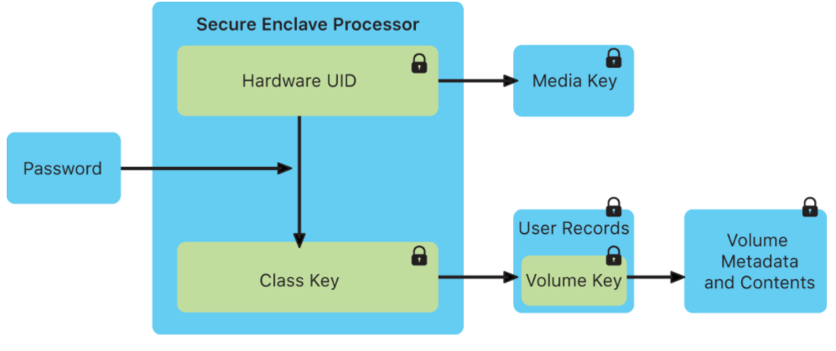
  iOS Security Model- Secure enclave …
The Secure Enclave processor

Slide 15
  iOS Security Model- Touch ID
Touch ID is fingerprint recognition feature designed by Apple.
It has been part of iPhones since iPhone 5S until iPhone 8.
iPads, and MacBook user account can have managed fingerprints using Face ID.
As of iOS 8, it was integrated as a means of authentication to third-party app.
In 2017 Apple released the iPhone 8 and 8 Plus with Touch ID, alongside the iPhone X which instead incorporated Face ID.
In Touch ID management, apps have no direct access to the Secure Enclave or the registered fingerprints- use LocalAuthentication framework.

Slide 16
  iOS Security Model- Code signing
  A runtime security feature that attempts to prevent unauthorized apps from running on the device
  It validates the app signature each time it is executed.
  For an app to run on iOS device, it must first be signed by a trusted certificate.
  Developers can install trusted certificates on a device through a provisioning profile signed by Apple.

Slide 17
  iOS Security Model- Sandboxing
  All third-party applications on iOS run within a sandbox.
  It is a self-contained app environment that isolates from the OS and other apps.
  It introduces significant security to the platform and limits the damage that malware can do.
  This helps in the event that a malicious application has subverted the App Store review process.
  Each App is contained in its own directory and separation is maintained by XNU sandbox kernel extension (seat belt).

Slide 18
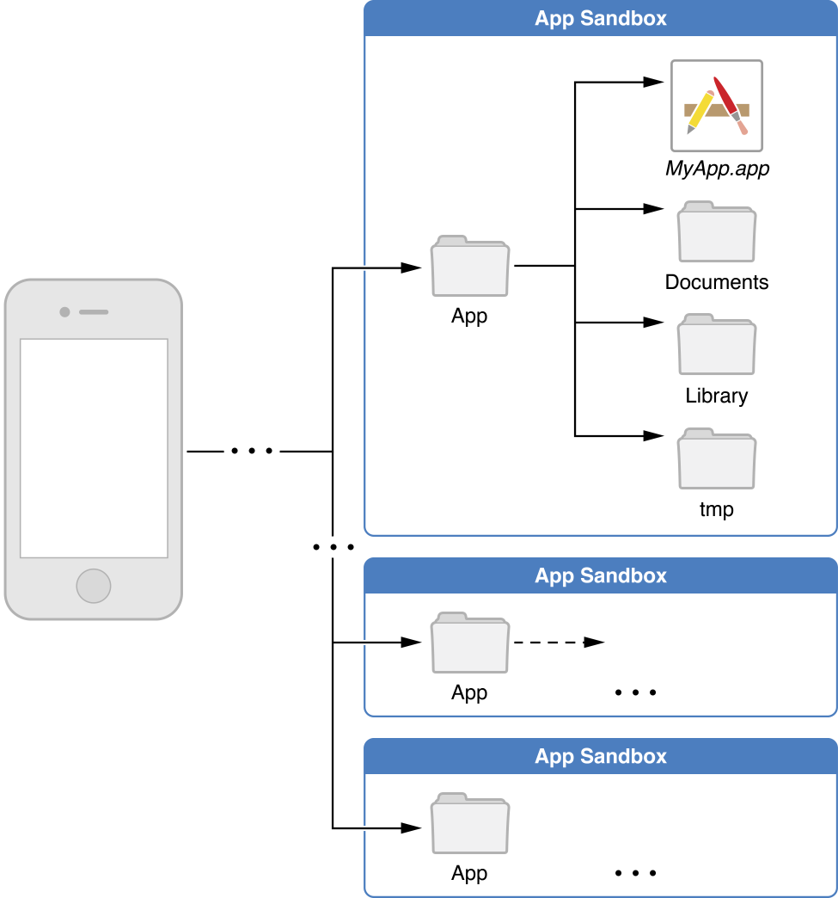
  iOS Security Model- Sandboxing …

Slide 19
  iOS Security Model- data-at-rest encryption
  By default, all data on the iOS is encrypted using block-based encryption (Advanced Encryption Standard- AES).
  It is encrypted with the file system key- generated on first boot and stored in block 1 of a NAND flash storage.
  The device uses this key during the startup process to decrypt the partition table and the system partition.
  The filesystem is encrypted only at rest.
  When the device is turned on, the hardware-based crypto accelerator unlocks the filesystem.
  This key helps for device’s remote wipe capability as destroying the file system key causes the filesystem to become unreadable.

Slide 20
  iOS Security Model- Exploit Mitigation Features
What is an exploit?
An exploit is a piece of- software, a chunk of data, or a sequence of commands that takes advantage of a bug or vulnerability to cause unintended or unanticipated behavior to occur on computer software, hardware, or something electronic. Wikipedia

Slide 21
  iOS Security Model- Exploit Mitigation Features …
  iOS employs several exploit mitigation technologies to protect devices.
  ARM’s Execute Never (XN) prohibit memory pages from writeable and executable at the same time- but can be bypassed using return-oriented programming (ROP).
  ROP controls the call stack, hijacks program control flow and execute chosen machine instruction sequences
  Address space layout randomization (ASLR) randomizes code locations- makes it complex for ROP to exploit memory corruption vulnerabilities.
  More on this- https://www.arm.com/blogs/blueprint/arm-exploit-mitigation

Slide 22
  More on security features- App permissions
  The permission model on iOS segregates data in classes.
  Typically access classes - location services, contacts, calendar, photos, microphone, motion, Bluetooth, and social media data.
  When an app requires access to data protected by these privacy classes, it must prompt to allow or deny access.

Slide 23
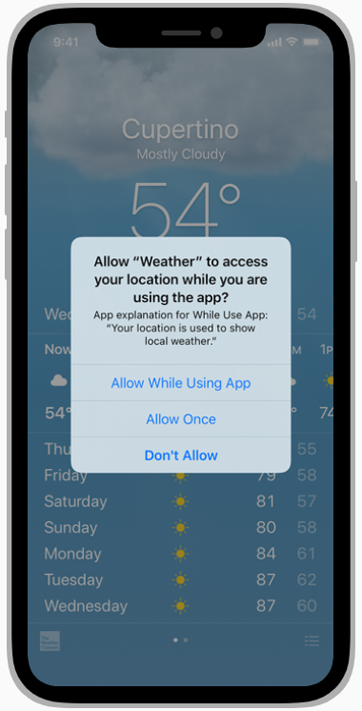
  More on security features- App permissions …
Request for permission to …

Slide 24
  More on security features- Data protection API
It is the use of API that implements built-in hardware encryption to protect sensitive data stored on client-side.
  fine-grained access control for user data stored in flash memory.
The APIs are built on top of the Secure Enclave Processor (SEP)
Data protection architecture overview

Slide 25
  More on security features- iOS Keychain
iOS Keychain is a specialized database for storing metadata and sensitive information such as secrets and passwords.
It is Apple's password management system where account names, passwords, and credit card numbers are securely stored and synced across all devices using iCloud.
Technically, Keychain is highly secure in which the Keychain passwords and credit card numbers are encrypted with 256-bit AES.

Slide 26
  Reverse engineering
It is about how to get iOS binaries into a format one can work with, and how to identify some security-relevant features in these binaries.
iOS apps compile to native code using the Mach-O (object) file format.
Multiple Mach-O files (fat binaries) can be archived in one binary to provide support for different architectures- ARMv7, ARMv7s, ARM64.
Apps downloaded from the App Store are encrypted and later decrypted at run time, on-device by the loader.

Slide 27
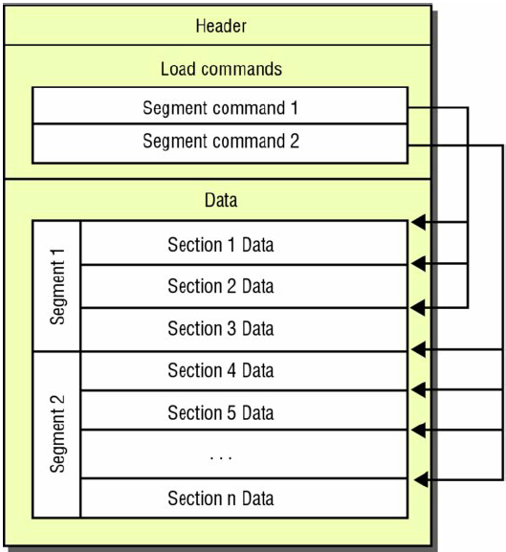
  Reverse engineering …
Components of the Mach-O file format:
  Header- used to identify the file format
  Load commands- specify location of symbol table, file’s encrypted segments, names of shared libraries, etc.
  Data- contain code or data that gets mapped to virtual memory by the dynamic linker.

Slide 28
  Reverse engineering …
Verify the presence of vulnerabilities using otool by inspecting the Mach-O header.
Use otool to verify if stack smashing is enabled in iOS app- it protects exploits against stack overflow attacks.
  The random value (canary) is placed on stack before local variables to protect saved base pointer, instruction pointer and function arguments.
  The value of the canary is then verified when the function returns to see whether it has been overwritten.
To reverse engineer Apps, you must disassemble and decompile your target application.. and inspect the features.
Reverse engineering tools

Slide 29
  Jailbreaking
Jailbreaking- a process by which iOS is modified to remove restrictions and get greater user control over the device.
The reason for jailbreaking is to install third-party applications that Apple couldn’t approve in the App Store.
Disadvantages- bricking, loss of warranty, vulnerable to malware, etc.
Jailbreaking vs Unlocking- Jailbreaking removes software restrictions while unlocking removes restrictions imposed by cellular provider.
It is possible to use iTunes and App Store after jailbreaking but some App Store apps include jailbreak detection which prevents running.
Does jailbreaking prevent from updating iOS?
Notes:
If your iOS device is jailbroken and you decide to update it to the latest version of iOS, you will lose the jailbreak.
Source: book and https://www.idownloadblog.com/jailbreak/

Slide 30
  Defensive strategies to protect iOS apps
Protecting data in iOS apps (more discussion on this).
Avoiding injection vulnerabilities.
Securing apps with binary protections.

Slide 31
  Protecting data in iOS apps
Avoid storing sensitive data in NSDefaults- consider UIWebView for suddenly stored data, etc.
Plan about state transitions in the app and what data should be accessible in each state.
Determine how access to the app will be protected. Example, use client-side authentication with Touch ID.
Identify data entry points early and implement parse rules /validation along the way.
Consider the impact of any third-party libraries that might be used within the application.
Notes:
Where possible, you should also combine it with authentication via iOS’ LocalAuthentication framework and TouchID, which can offer validation that the
user is physically present providing no tampering has taken place. You should also consider several
important factors when implementing client-side authentication: namely whether the passcode is stored and
if so, where; how it is validated; the key space of the passcode; and how other application areas will be
protected until the authentication has been completed.

Slide 32
  Guidelines for implementing encryption
Use tried-and-tested encryption algorithm- e.g., use AES-XTS with a key size of 256 and hashing using SHA-256.
Generate key using accepted key derivation function- e.g., keybag in Apple uses PBKDF2 with 10,000 iterations.
The key used to encrypt data should itself be encrypted- also always keep the user input as large as possible.
Notes:
PBKDF2 - password-based key derivation function
Always keep the user input, to derive a key, as large as possible.

Slide 33
  Protecting data in transit
Certificate pinning checks which certificates are considered valid for a particular website- limiting risk
Pinning remains an important security control and is recommended for any application.
This protection gives additional confidence that the host being connecting to is who it reports to be.
It requires embedding a public key within an app that allows to compare it against one provided.
Notes:
This protection gives additional confidence that the host being connecting to is who it reports to be and negates the impact of a compromised Certificate Authority.
It requires embedding a public key within an app that allows to compare it against one provided by a server during SSL session

Slide 34
  Issues for discussion (1)
Why do enterprises employ their own distribution centers?
What is a jailbreak? What are the advantages and disadvantages?
Does jailbreaking prevent from updating iOS?
What are the key features in iOS 14? Identify any three features in https://www.apple.com/ios/ios-14/features/ and discuss.
Which of the following is not a high-level component of the iOS architecture? Cocoa touch, Media, Emulator, Core services , Core OS
Notes:
Why do enterprises employ their own distribution centers?
This is used by organizations having internal applications that they do not want to be available in the App Store.
Does jailbreaking prevent from updating iOS?
If your iOS device is jailbroken and you decide to update it to the latest version of iOS, you will lose the jailbreak.
Source: book and https://www.idownloadblog.com/jailbreak/

Slide 35
  Issues for discussion (2)
(Protecting data in iOS apps) Watch the video (in link) on data encryption and decryption in Swift.
Based on the video, write the object(s) relevant to the topics covered in this lecture- and discuss.
Explore and provide a description of the RNCryptor object?
Notes:
RNCryptor uses either a 256-bit random key or a password. It extracts a 512-bit pseudorandom key (PRK) from this using HKDF-Extract or PBKDF2. It then uses HKDF-Expand to expand this key material into the IV, a validation token, the encryption key, and the HMAC key.
Encrypt ciphertext with AES-256; Compute HMAC with SHA-512-256
HMAC stands for Keyed-Hashing for Message Authentication. It's a message authentication code obtained by running a cryptographic hash function (like MD5, SHA1, and SHA256)
https://github.com/RNCryptor/RNCryptor-Spec/blob/master/draft-RNCryptor-Spec-v4.0.md

Slide 36
  Issues for discussion (3)
(Group work) Consider the following steps to make iOS Apps secure (described here).
  Store confidential data in a secure place (1)
  Make networking layer invulnerable (2)
  Think about your secret (like API) keys (3)
  Be careful with 3rd party integration (4)
  Keep learning about new vulnerabilities (5)

Slide 37
  Issues for discussion (3) …
Steps to make iOS Apps secure …
Each of the steps mentioned in previous slide are important security measures. However, ….
Form a team, and then take any one of the steps (random picking).
Discover from the Web and take note of list of argument points why the (random picked) step is more important than the other four.
Present your work to classmates by posting your notes on menti.

Slide 38
  Next topic
Cross-platform mobile applications and security

